Slide 1
Credit Card Customer Segmentation Surfacing hidden opportunities in target customers
Schulich School of Business
MBAN 6400 Project Part B
Group-1 Members:
Zubin Moosa (218698811)
Olivier Smith (219131242)
Xingkai Wu (211179066)
Junge Xu (218472837)
Yangming Ye (218472654)
Xiaohan Zhou (212998332)
“The work we submitted as part of this assignment is original, and due credit is given to others where appropriate. We accept and acknowledge that that each member of our team is equally responsible for if the assignment found to be plagiarized in any way, and we will be subject to school’s Academic Integrity policy”

Slide 2
Executive Summary
This project uses data from nearly 9,000 credit card users to identify 5 distinct customer segments.
This project recommends a unique strategy for each of these 5 customer segments ranging from promotional offers to increasing credit limits where appropriate.
With these recommendations, our team expects to increase share of wallet, maximize risk-adjusted returns, retain valuable customers, and maximize profitability.

Slide 3
Agenda
Introduction
Exploratory Data Analysis (EDA)
Clustering Model
Clusters Comparison
Recommendations

Slide 4
Introduction
The project aims to identify key customer segments and develop informed strategies to drive revenue & growth in each segment.
Increase Share of Wallet – Identify high-potential cardholders and incentivize them to become their primary card-users
Maximize Risk-Adjusted Returns - Selectively upgrade card limits/tiers for maximum risk-adjusted returns
Retain Valuable Customers - Accurately evaluate customer value and limit attrition risk
Maximize Profitability - Migrate select customers to more profitable payment products and engagement channels

Slide 5
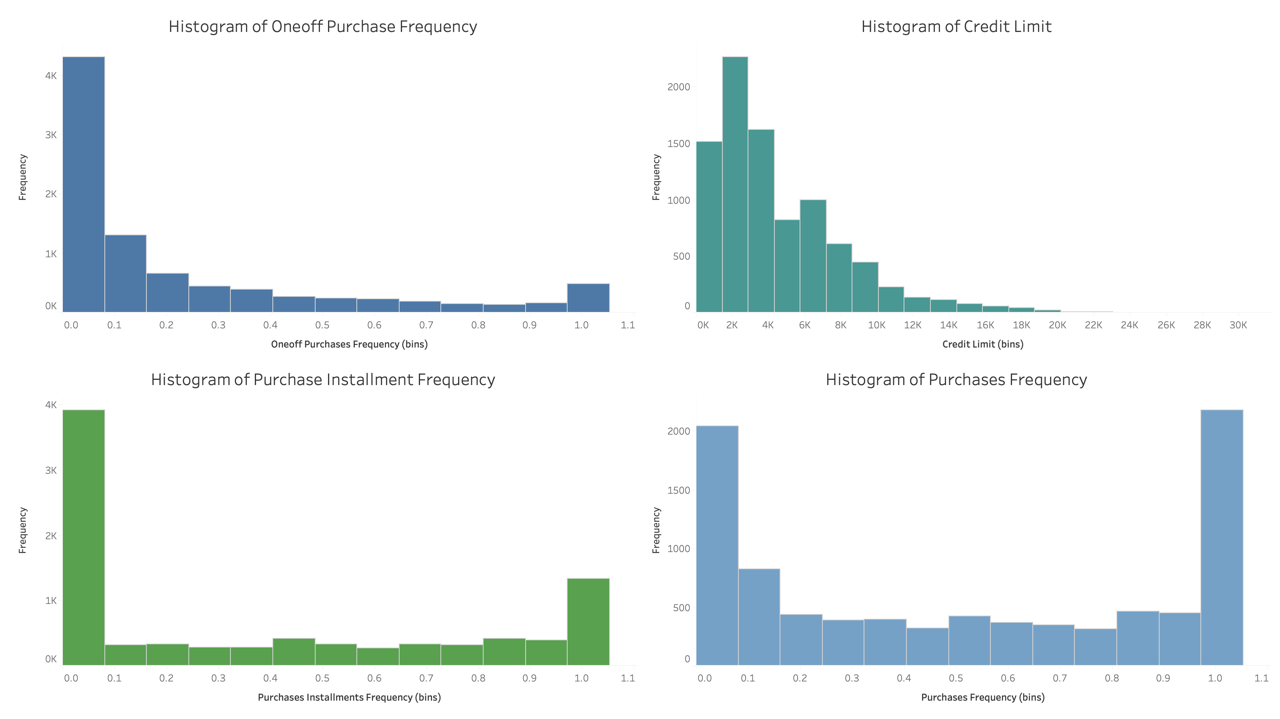
EDA
Many of these variables show bi-modal distributions, suggesting customer subsegments.

Slide 6
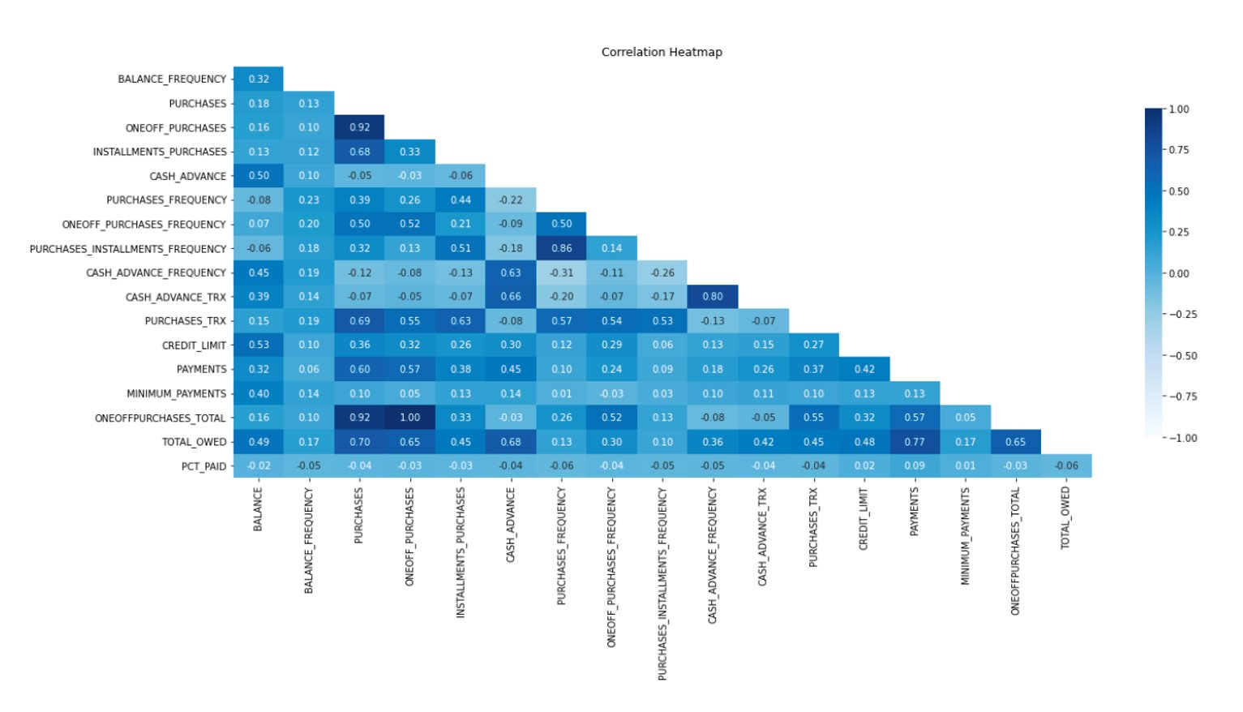
EDA
Strong Positive Correlation
Statistically Insignificant Correlation
Several variables show a strong positive correlation, meaning they may provide redundant information. We may have to drop some of these redundant variables during clustering.

Slide 7

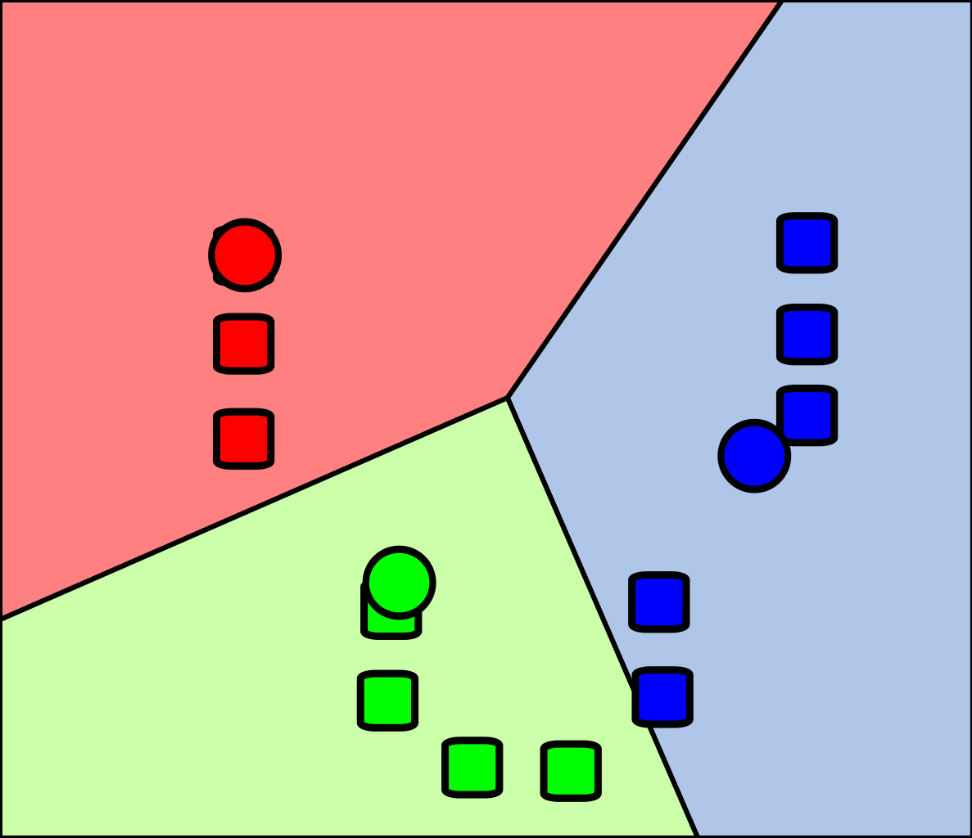
General Workflow
Sample size: 8,950
Tools: Jupyter Notebook*
Method: PCA, Kmeans
Between Segment EDA and Statistical Analysis
Principal Component Analysis
KMEANS
Clustering Validation (Visualization)
Recommendation
Phase 2 Starts
Project Complete
* Check reference section for code file
Notes:
In this project, our workflow includes but not limited to data transformation, missing data imputation, exploratory data analysis, scaling, and outlier resolution.

Slide 8
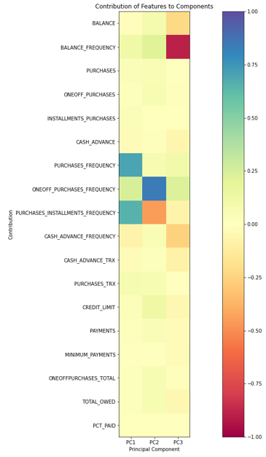
Principal Component Analysis (PCA)
3 principal components explained 92% of the variance in data.
PC1： 0.69 purchase frequency & 0.65 purchase installment frequency
PC2： 0.84 one-off purchase frequency
PC3： -0.89 balance frequency
purchase frequency and one-off purchase frequency are highly correlated (r = 0.501)
3 out of 4 features have been selected :
1. purchase frequency
purchase installment frequency
one-off purchase frequency
balance frequency

Slide 9
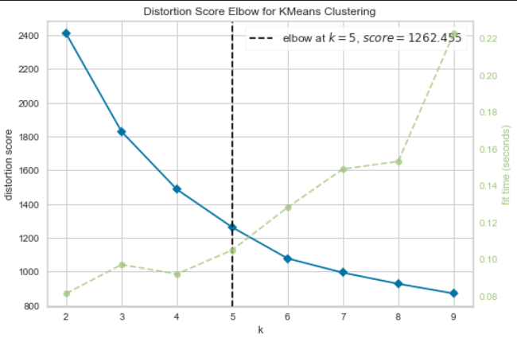
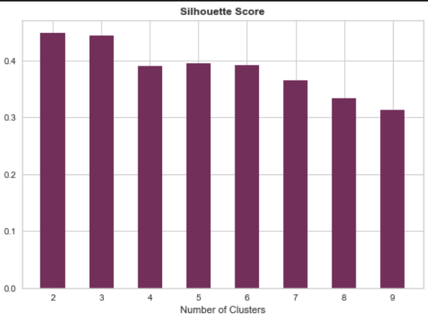
KMeans: Two Selection Methods
*
The "elbow" point (K=5)
Silhouette Score:
Number of clusters=5:
looks to be most appropriate than others
Adding additional data samples does not change cluster membership much
* See appendix section for details

Slide 10
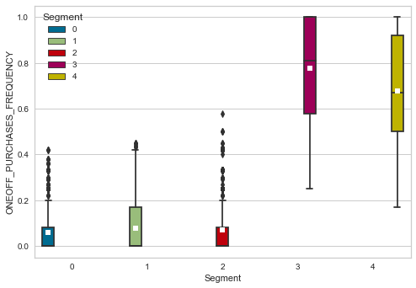
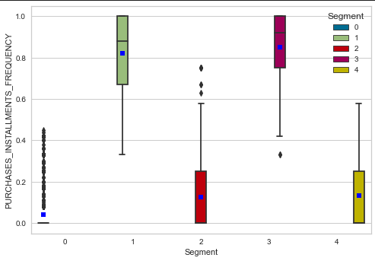
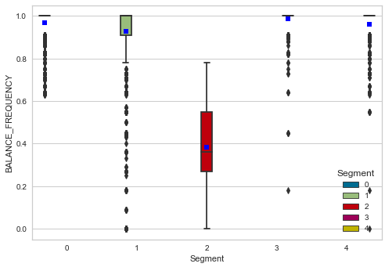
Between Segment EDA & Statistical Analysis
(Eyeball Tests)
One-off Purchase Frequency
Installment Purchase Frequency
Balance Frequency
Segments 3&4 make more one-off purchases.
Segments 1&3 use installments more often
Segment 2’s balance changes less than other segments

Slide 11
Cluster Validation
Test * | Findings
ANOVA | Statistically SIGNIFICANT DIFFERENT means across segments for all three major features!
Pairwise T-test Validation | NO SIGNIFICANT DIFFERENCE: oneoff_purchases_frequency between segments 1&2 purchase_installments_frequency between segments 2&4 SIGNIFICANT DIFFERENCE: balance_frequency between all pairwise segments
MANOVA | Statistically SIGNIFICANT DIFFERENT multivariate mean across segments for all three major features!
* See appendix section for details

Slide 12
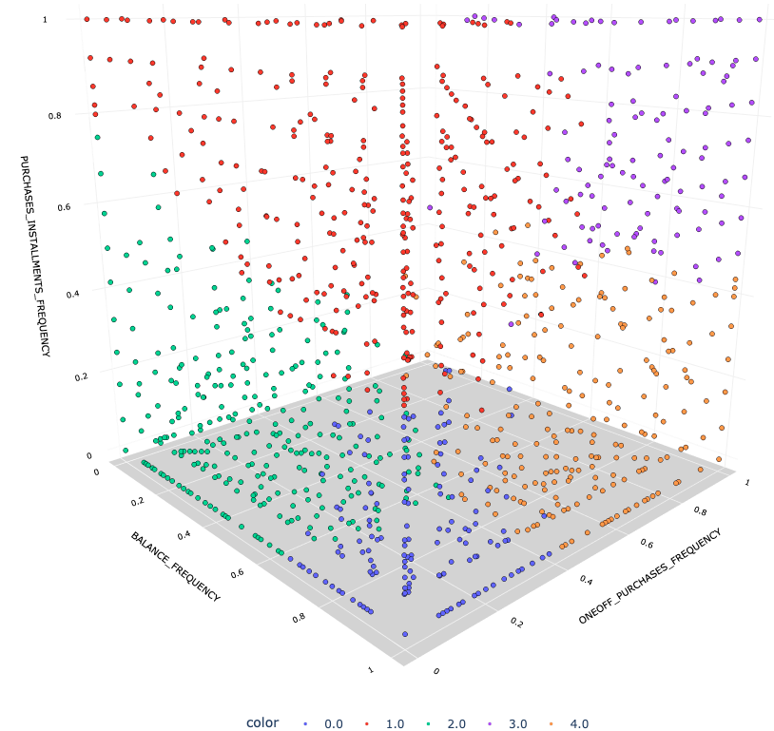
Cluster Validation (Visualization) & Limitations
The points do not overlap with each other.
There are clear separation between clusters.
Key Limitations:
Frequency data is on a 0 to 1 scale, no knowledge about the real reference level to derive proper recommendation;
K-Means cannot analyze categorical variables;
PCA has hard time working with outlier data.

Slide 13
Identifying Segments
Segments were compared across five features to identify credit card usage profiles.
SEGMENTS | S0 | S1 | S2 | S3 | S4
Balance Frequency | High | High | Low | High | High
One-Off Purchase Usage | Low | Low | Low | High | High
Instalment Purchase Usage | Low | High | Low | High | Low
Cash Advance Usage | High | Low | Low | Low | Low
Credit Limit | Low | Low | Low | High | Moderate

Slide 14

Identifying Segments
Cashless
Chris (S0)
Frequent credit card users with low credit limits, rarely make purchases but use cash advance frequently.
Instalment Ivan (S1)
Frequent credit card users with low credit limits, prefer to purchase in instalments, rarely use cash advance.
Bored Bobby (S2)
Infrequent credit card users with low credit limits, rarely make any kind of credit card purchase and rarely use cash advance.
Wealthy Wendy (S3)
Frequent users with high credit limits, rarely use cash advance but make a lot of one-off and instalment purchases.
Safe
Suzie (S4)
Frequent users with moderate credit limits, prefer to purchase outright, rarely use cash advance.
Notes:
https://www.istockphoto.com/vector/flat-avatars-different-portraits-of-men-and-women-diverse-ages-professional-team-gm1176534155-328061069

Slide 15




Business Recommendations
Cashless Chris (S0) – Incentivize purchasing instead of cash advances;
Instalment Ivan (S1) – Offer promotional interest rates for instalment purchases;
Bored Bobby (S2) – Re-engage with offers and promotions;
Wealthy Wendy (S3) – Provide premium perks to retain;
Safe Suzie (S4) – Increase credit limit & encourage larger purchases.
With these recommendations, we expect to...
Increase
Share of Wallet
Maximize
Risk-Adjusted Returns
Retain Valuable Customers
Maximize Profitability

Slide 16
Thank you
Schulich School of Business
MBAN 6400 Project Part A

Slide 17
References
Fiorio, L., Mau, R., Steitz, J., & Welander, T. (2014, May). New frontiers in credit card segmentation: Tapping unmet consumer needs. McKinsey. Retrieved January 19, 2022, from https://www.mckinsey.com/~/media/mckinsey/dotcom/client_service/Financial%20Services/Latest%20thinking/Payments/MoP19_New%20frontiers%20in%20credit%20card%20segmentation.ashx
Forte Consultancy. (2015, May 5). Credit Card Customer Segmentation. Forte Consultancy. Retrieved January 19, 2022, from https://forteconsultancy.wordpress.com/2014/09/12/credit-card-customer-segmentation/
Code file:
https://github.com/xwu0223/MBAN-6400-Project

Slide 18
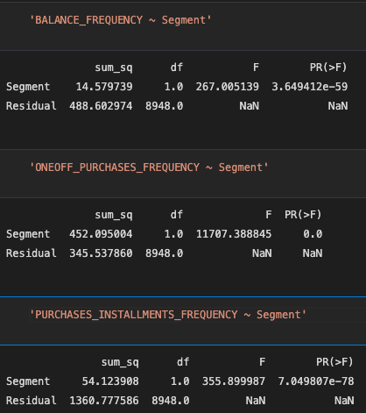
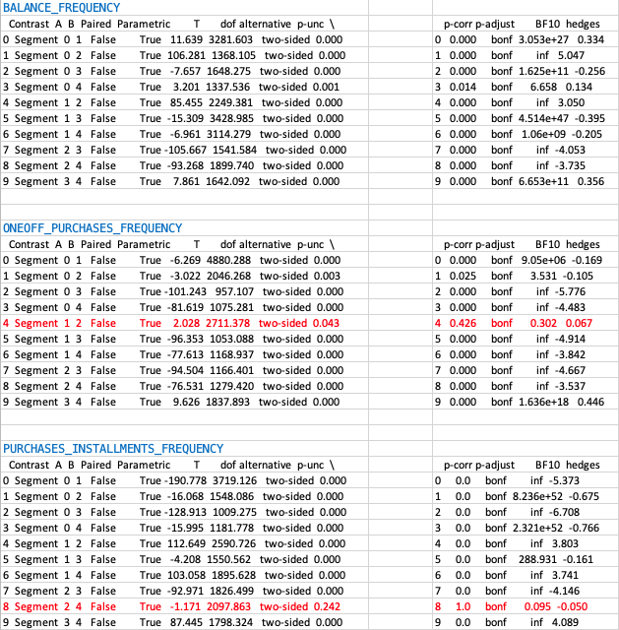
Appendix 1: ANOVA
Appendix 2: Pairwise t-test

Slide 19
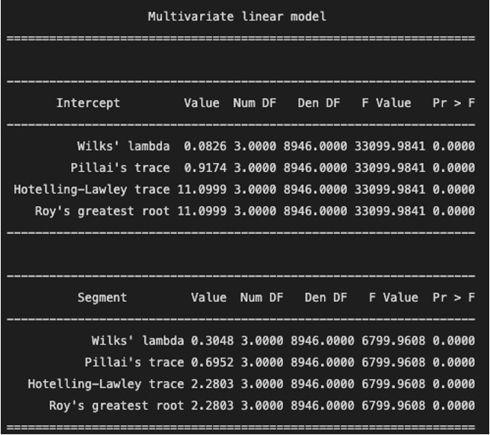
Appendix 3: MANOVA

Slide 20
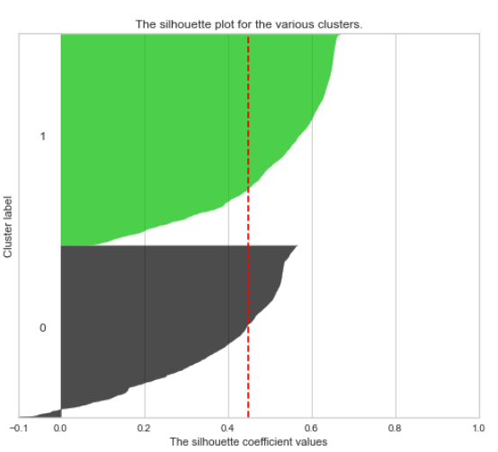
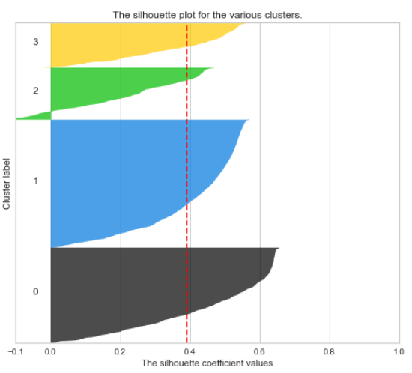
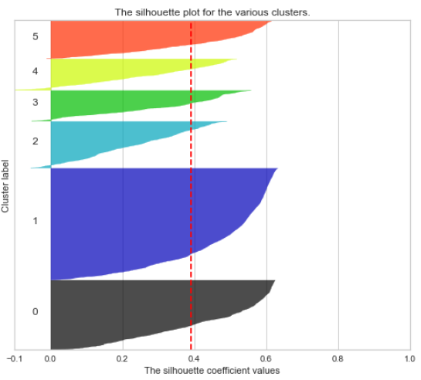
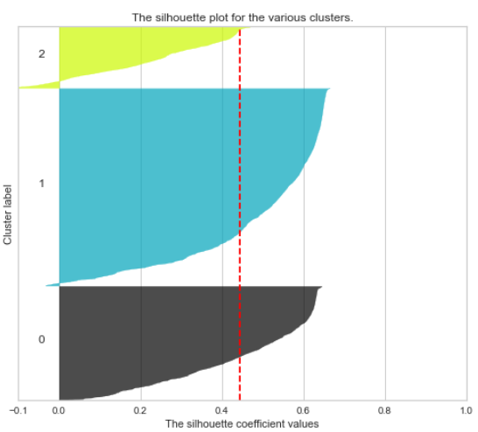
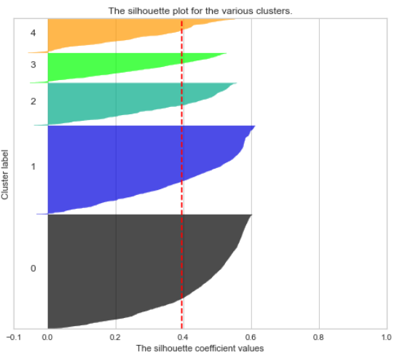
Appendix 4: Kmeans - Silhouette
K=2
K=4
K=6
2 groups have different size
K=3
K=5
Group 2 Below Avg Score
Final choice

